Slide 1
Why use hypnosis clinically?
Utilizing hypnotic phenomena – applications in clinical practice.

Slide 2
Hypnotic Phenomena: Important
You won’t see all of these phenomena all of the time
You may see some of these phenomena some of the time

Slide 3
Hypnotic Phenomena
These phenomena don’t happen spontaneously but require an appropriate suggestion
Physiology mimics that of the suggested (imagined) experience

Slide 4
Hypnotic Phenomena
Vision:
Blindness
Total (evidence from visual evoked potentials)
Selective e.g. numbers missing
Visual hallucinations
Hearing:
Deafness (evidence from auditory evoked potentials)
Auditory hallucinations

Slide 5
Hypnotic Phenomena
Touch
Numbness
Hypersensitivity
Smell
Taste
Voluntary muscle:
Increased strength?
Rigidity/levitation
Automatic movements

Slide 6
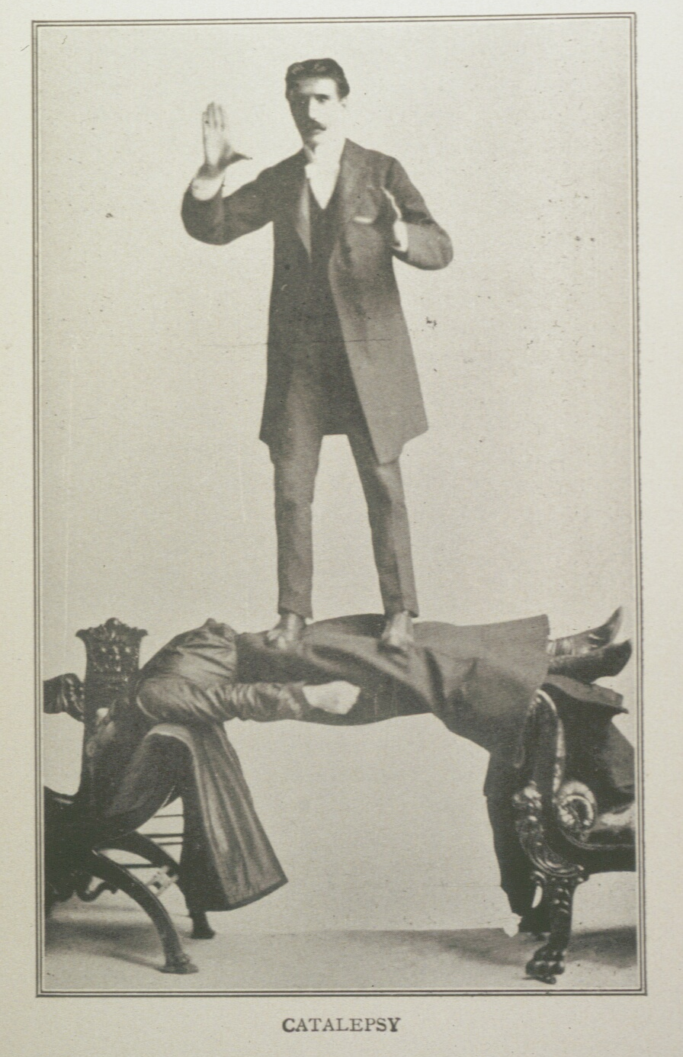

Slide 7
Alteration of Perception
Pain
Reduce acute pain
Manage chronic pain
In labour/surgical interventions
Time
Distortion
Regression
Sound
Tinnitus
‘It won’t bother you’

Slide 8
Access to Unconscious Processes
Psychosomatic conditions
Irritable bowel syndrome
Insomnia
Psychosexual problems
Migraine
Amazingly effective in PTSD
Phobias
Increased awareness of intuition

Slide 9
Modification of Physiology
The stress response
Anxiety Relaxation
Inflammation
burns, eczema, asthma
Changes in immune response
Exam stress
Cancer: psychoneuroimmunology

Slide 10
Modification of Physiology
Hormonal
Irregular periods / infertility
Reduction of bleeding
Surgery
Menorrhagia
Reduction of salivation

Slide 11
Other Features of Hypnosis
Enhanced memory???
Dissociation
Hidden Observer
Ideomotor responses
Post hypnotic suggestion

Slide 12
Important
You won’t see all of these phenomena all of the time
You may see some of these phenomena some of the time
Responses may vary in the same person over time depending on their needs
Responses may vary with different combinations of patient and therapist

